Slide 1
A Simple Syntax-Directed Translator

Slide 2
Syntax
The syntax of a programming language describes the proper form of its programs. For specifying syntax, we present a widely used notation, called context-free grammars.

Slide 3
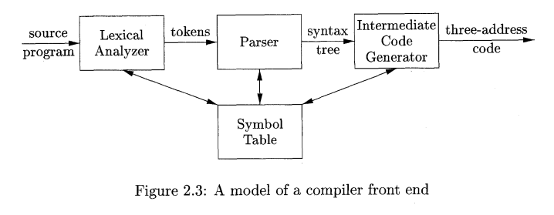
A model of a compiler front end

Slide 4
Context Free Grammar
Utilized to describe the Syntactic Structure of a Language.
Describes hierarchical structure with production rules.
It has four components/Touples:
A Set of Tokens or Terminal Symbols, T
A Set of Non-terminals/ variables, NT
A Set of Production Rules
Each Rule Has the Form, NT -> {T, NT}*
A Non-terminal Designated As the Start Symbol

Slide 5
Example
Que: Lists the digits separated by plus or minus symbol.
Ans: The following grammar describes the syntax of the expression. The productions are:
list -> list + digit
list -> list – digit
list -> digit
digit -> 0 | 1 | 2 | 3 | 4 | 5 | 6 | 7 | 8 | 9
So, we can write
list -> list + digit | list - digit | digit

Slide 6
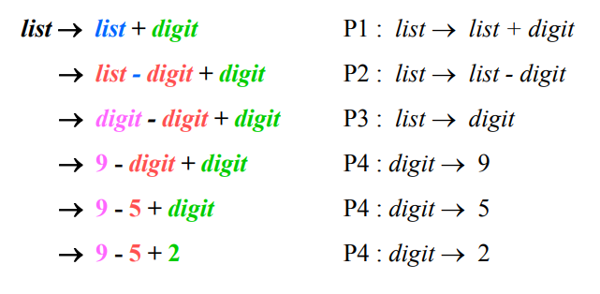
Using the CFG defined on the earlier slide, we can derive the string: 9 - 5 + 2 as follows:
This is an example of leftmost derivation, because we replaced the leftmost nonterminal in each step.

Slide 7
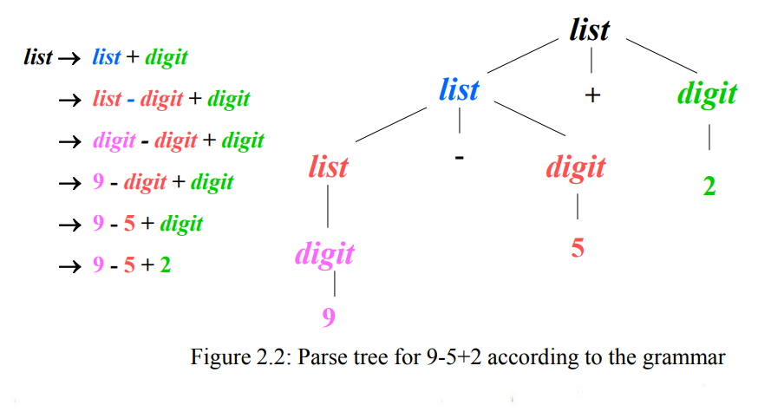
This derivation could also be represented via a Parse Tree (parents on left, children on right)

Slide 8
Some Information
A string of tokens is a sequence of zero or more tokens.
The string containing with zero tokens, written as ε, is called empty string.
A grammar derives strings by beginning with the start symbol and repeatedly replacing the non terminal by the right side of a production for that non terminal.
The token strings that can be derived from the start symbol form the language defined by the grammar.
Given a CF grammar we can determine the set of all strings (sequences of tokens) generated by the grammar using derivation:
We begin with the start symbol
In each step, we replace one nonterminal in the current sentential form with one of the right-hand sides of a production for that nonterminal

Slide 9
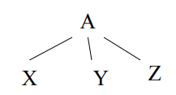
Parse Tree
A parse tree pictorially shows how the start symbol of a grammar derives a string in the language.
If nonterminal A has a production A → XYZ, then a parse tree may have an interior node labeled A with three children labeled X, Y, and Z, from left to right:
More Formally, a Parse Tree for a CFG Has the Following Properties:
Root Is Labeled With the Start Symbol
Leaf Node Is a Token or ε
Interior Node is a Non-Terminal
If A -> X₁ X₂ … X_{n} is a production, then node A has immediate children X₁ , X₂ , …, X_{n} where X_{i} is a (non)terminal or ε (ε denotes the empty string)

Slide 10
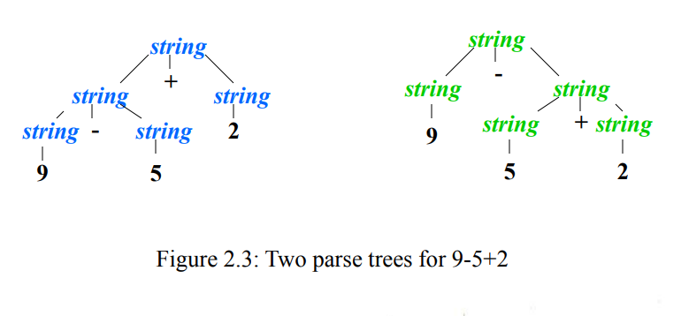
Ambiguity
A grammar may have more than one parse tree generating a given string of tokens.
Grammar:
string -> string + string | string – string | 0 | 1 | …| 9

Slide 11
Associativity of Operators:
By convention, 9+5+2 is equivalent to (9+5)+2 and 9-5-2 is equivalent to
(9-5)-2. When an operand like 5 has operators to its left and right, conventions
are needed for deciding which operator applies to that operand. We
say that the operator + associates to the left, because an operand with plus signs
on both sides of it belongs to the operator to its left. In most programming
languages the four arithmetic operators, addition, subtraction, multiplication,
and division are left-associative.
Some common operators such as exponentiation are right-associative. As
another example, the assignment operator = in C and its descendants is right associative;
that is, the expression a=b=c is treated in the same way as the
expression a= (b=c) .

Slide 12
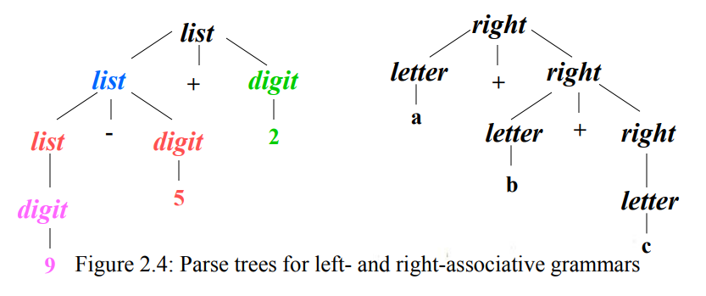
Associativity of Operators:
Left-associative operators have left-recursive productions
left -> left + term | term
String a+b+c has the same meaning as (a+b)+c
Right-associative operators have right-recursive productions
right -> term = right | term
String a=b=c has the same meaning as a=(b=c)

Slide 13
Precedence of Operators:
Consider the expression 9+5*2. There are two possible interpretations of this
expression: (9+5) *2 or 9+ (5*2). The associativity rules for + and * apply to
occurrences of the same operator, so they do not resolve this ambiguity. Rules
defining the relative precedence of operators are needed when more than one
kind of operator is present.
We say that * has higher precedence than + if * takes its operands before +
does. In ordinary arithmetic, multiplication and division have higher precedence
than addition and subtraction. Therefore, 5 is taken by * in both 9+5*2 and
9*5+2; i.e., the expressions are equivalent to 9+ (5*2) and (9*5) +2, respectively.

Slide 14
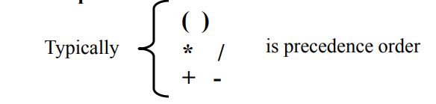
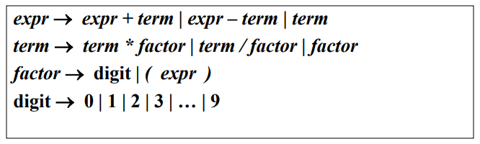
Precedence of Operators:
What does 9 + 5 * 2 mean?
This can be incorporated into a grammar via rules:
Precedence Achieved by:
expr & term for each precedence level
Rules for each are left recursive or associate to the left

Slide 15
Syntax-Directed Translation
An Syntax Directed Translation is a context free grammar + attributes + semantic rules:
Attributes associated to symbols
Rules associated to productions
Uses a CF grammar to specify the syntactic structure of the language.
An attribute is said to be,
Synthesized:
Depends on the children of node and itself
Can be evaluated in any bottom-up order (e.g. depth first)
Also terminals may have synthesized attributes.
Inherited: if its value at a parse-tree node is determined by the parents and siblings of the node and itself. Terminals may not have inherited attributes.

Slide 16
Postfix Notation
The postfix notation for an expression E can be defined inductively as follows:
If E is a variable or constant then Postfix(E) = E
If E is E1 op E2 then Postfix(E)
= Postfix(E1 op E2) = Postfix(E1) Postfix(E2) op
If E is (E1) then Postfix(E) = Postfix(E1)

Slide 17
Postfix Notation
Example 2.8 : The postfix notation for (9-5)+2 is 95-2+. That is, the translations
of 9, 5, and 2 are the constants themselves, by rule (1). Then, the
translation of 9-5 is 95- by rule (2). The translation of (9-5) is the same
by rule (3). Having translated the parenthesized subexpression, we may apply
rule (2) to the entire expression, with (9-5) in the role of El and 2 in the role
of E2, to get the result 95-2+.
As another example, the postfix notation for 9- (5+2) is 952+-. That is, 5+2
is first translated into 52+, and this expression becomes the second argument
of the minus sign.

Slide 18
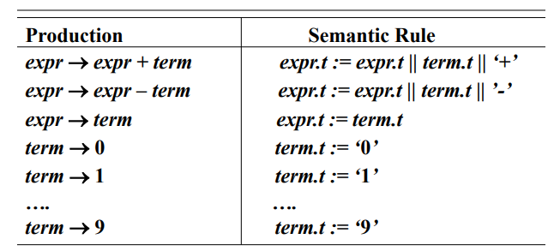
Each Production Rule of the CFG Has a Semantic Rule:
Note: Semantic Rules for expr define t as a “synthesized attribute” i.e., the various copies of t obtain their values from “children t’s”

Slide 19
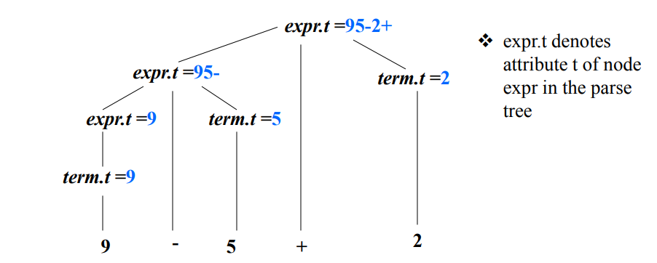
Semantic Rules are Embedded in Parse Tree (Annotated Parse Tree) :
It starts at the root and recursively visits the children of each node in left-to-right order
The semantic rules at a given node are evaluated once all descendants of that node have been visited.
A parse tree showing all the attribute values at each node is called annotated parse tree.

Slide 20
Syntax-Directed Definition:
Formal specification of translation is to specify the translation of a construct in terms of attributes associated with syntactic components.
Each Production has a Set of Semantic Rules.
Each Grammar Symbol has a set of Attributes.

Slide 21
Parsing
Parsing is the process of determining if a string of tokens can be generated by a grammar.
Parser must be capable of constructing the tree.
Two types of parser:
Top-down:
Starts at root
Proceeds towards leaves
Easily constructed by hands
Bottom-up:
Starts at leaves
Proceeds towards root
Efficient parsers are mostly bottom-up
Automatic parser generation tools tend to produce bottom-up parsers
Lookahead symbol – Current token of input is being scanned

Slide 22
Top-Down Parsing: Parse tree / derivation of a token string occurs in a top
down fashion.
For Example:
Production Rule:
type -> simple| ↑ id | array [ simple ] of type
simple -> integer| char | num dotdot num
Input is: array [ num dotdot num ] of integer
The top-down construction of a parse tree is done by starting with the root,
labeled with the starting nonterminal, and repeatedly performing the following
two steps:
At node N, labeled with nonterminal A, select one of the productions for A and construct children at N for the symbols in the production body.
Find the next node at which a sub tree is to be constructed, typically the leftmost unexpanded nonterminal of the tree.

Slide 23
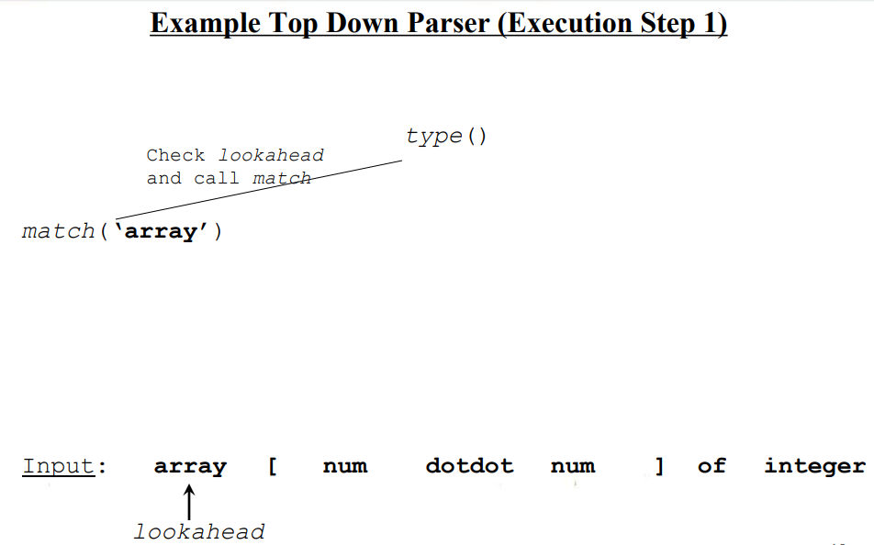

Slide 24
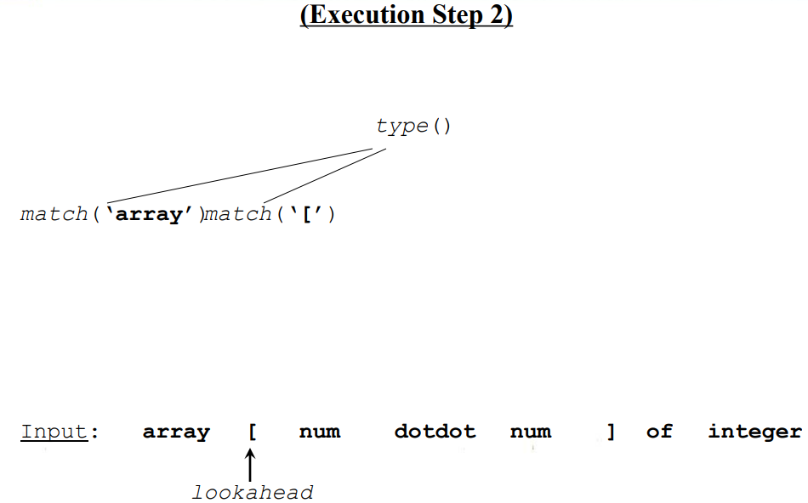

Slide 25
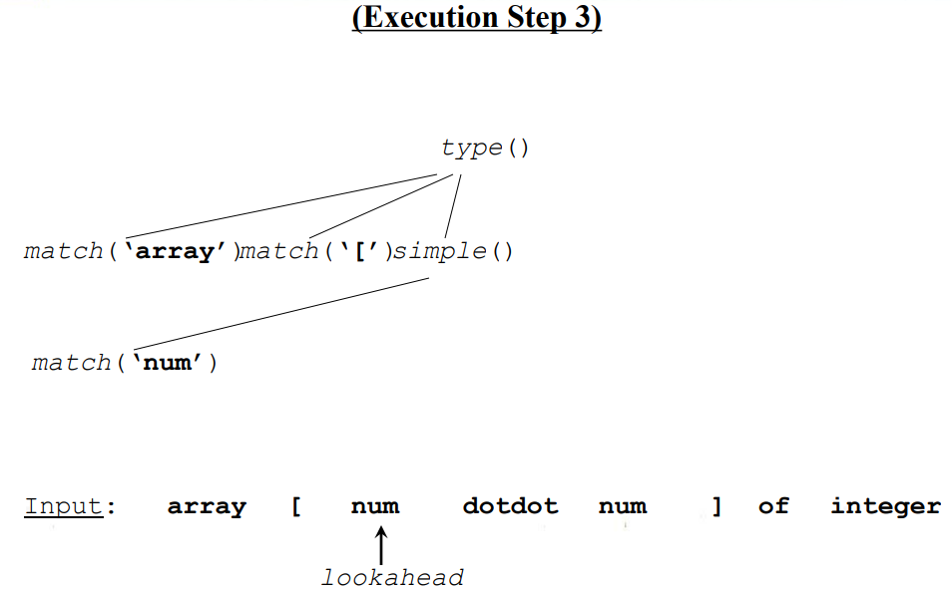

Slide 26
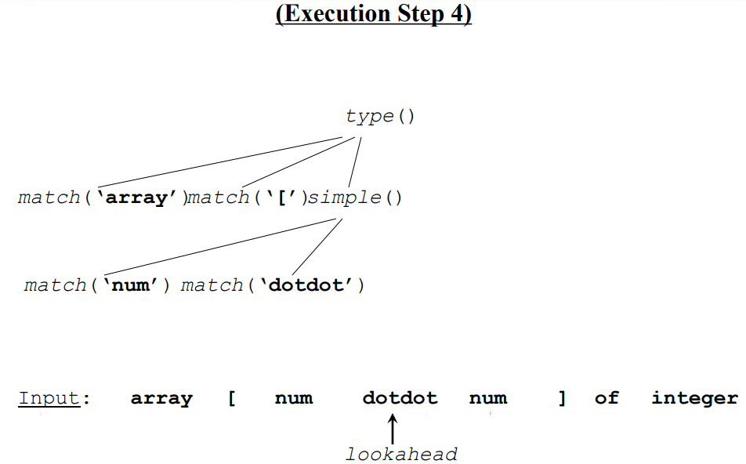

Slide 27
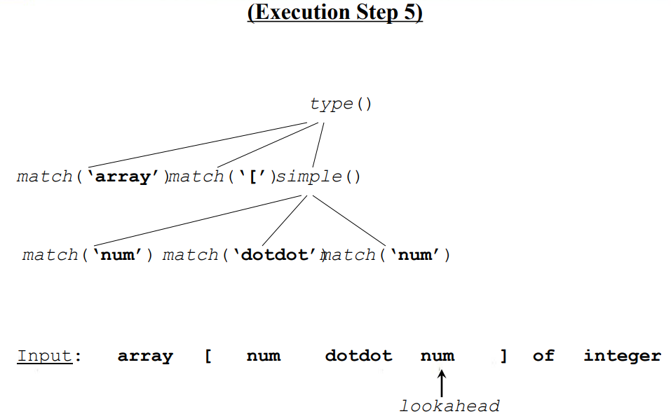

Slide 28
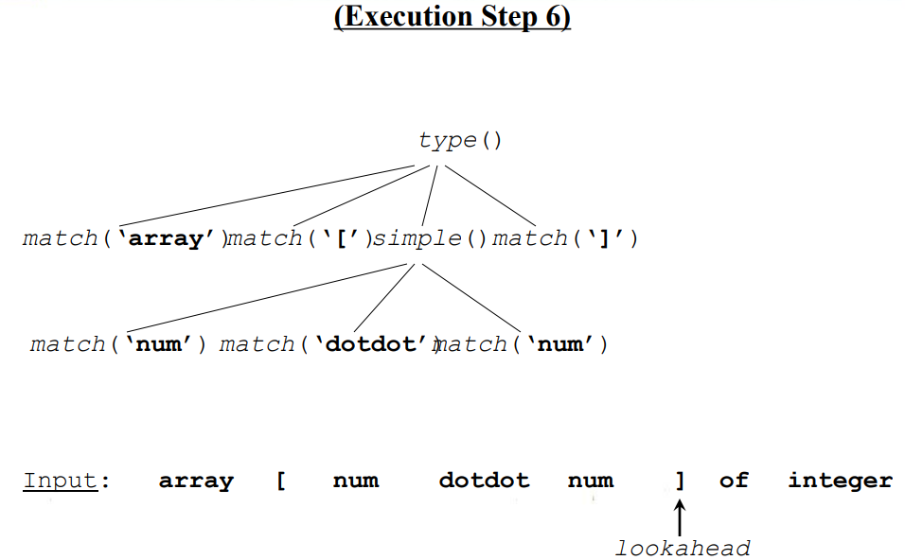

Slide 29
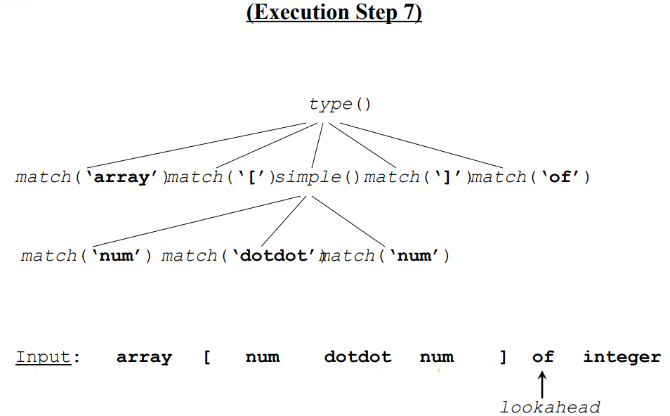

Slide 30
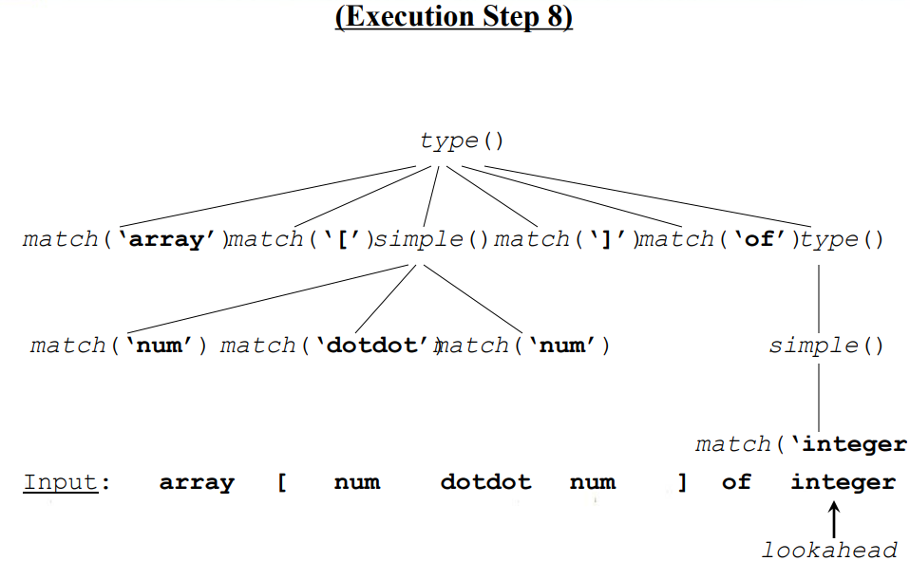

Slide 31
Predictive Parsing:
Predictive parsing is a special form of recursive descent parsing where we use one lookahead symbol to unambiguously determine the parse operations.
Recursive descent parsing is a top-down parsing method that,
Executes a set of recursive procedures to process the inputs.
Every nonterminal has one (recursive) procedure responsible for parsing
the nonterminal’s syntactic category of input tokens
When a nonterminal has multiple productions, each production is
implemented in a branch of a selection statement based on input lookahead information

Slide 32
Left Recursion: When a production for nonterminal A starts with a self reference then a predictive parser loops forever.
A -> A α
| β
| γ
We can eliminate left recursive productions by systematically rewriting the
grammar using right recursive productions.
A -> β R
| γ R
R -> α R
| ε

